Slide 1
Introduction to Deep Neural Network

Slide 4
Why Precisely Neural Network

Slide 5
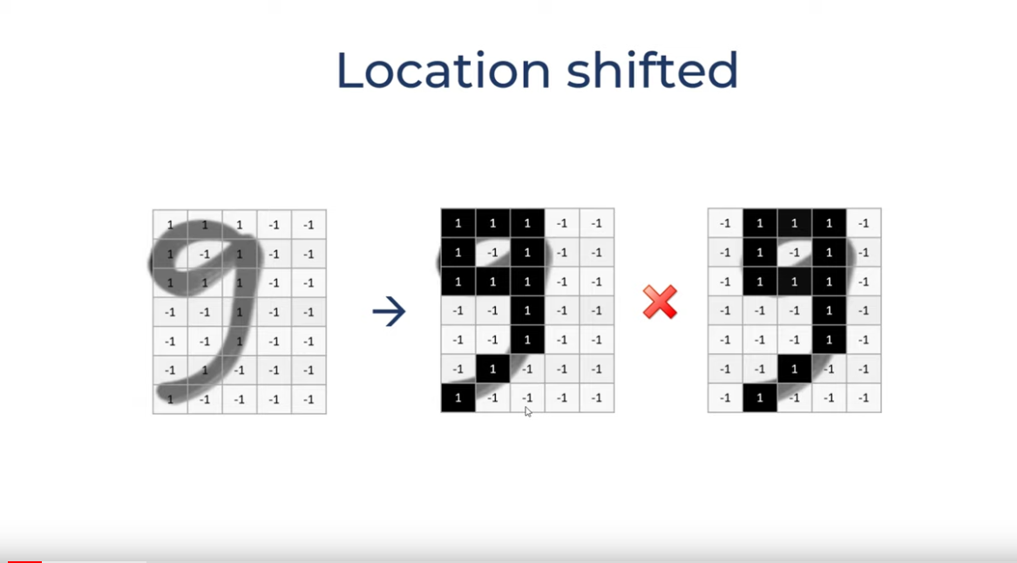
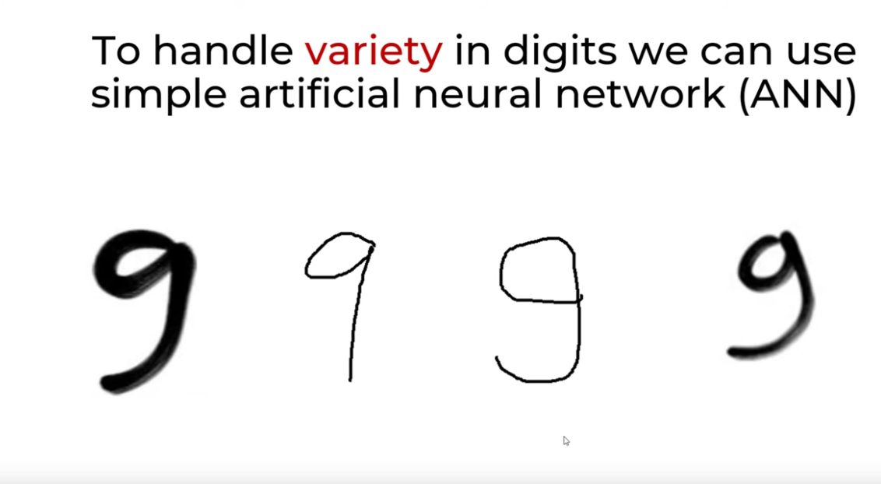

Slide 6
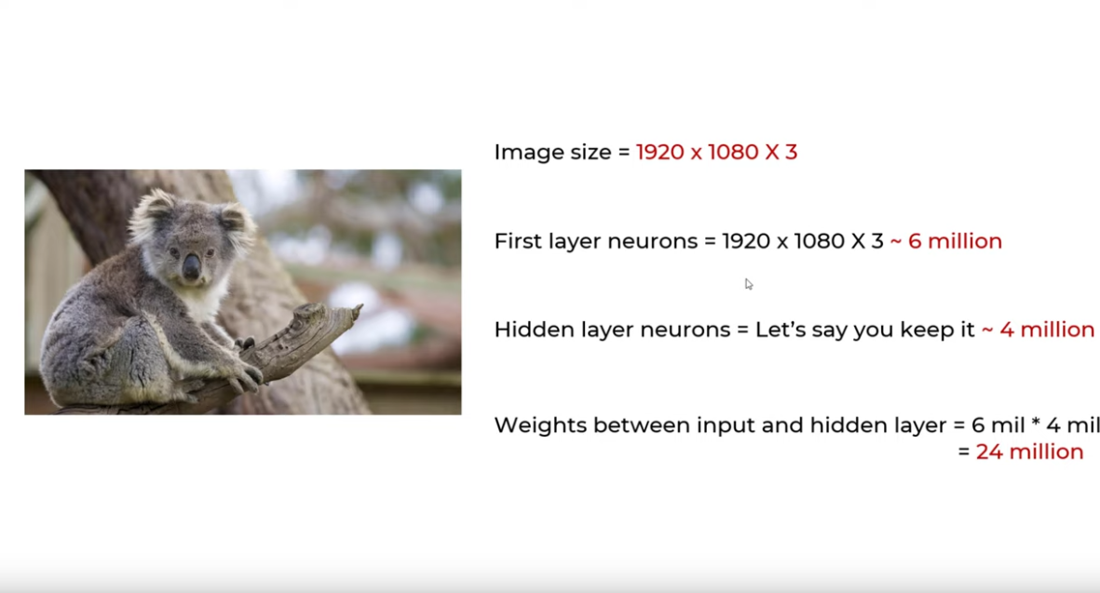
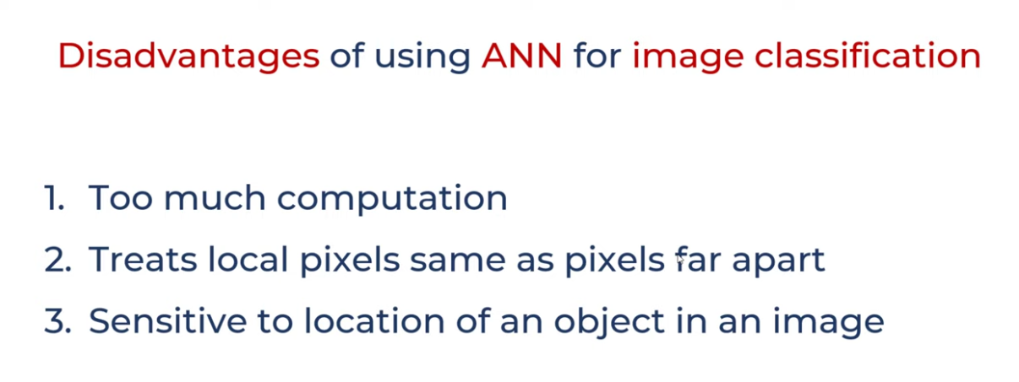

Slide 7
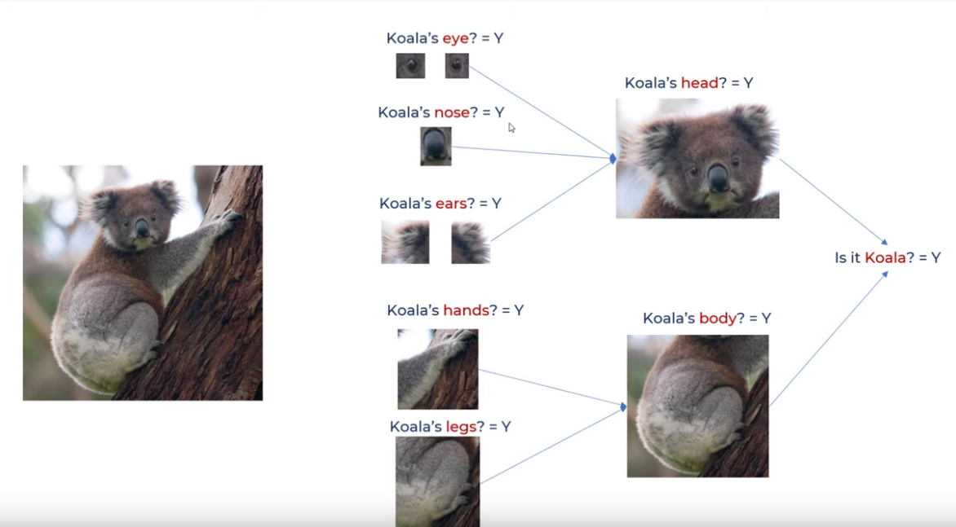
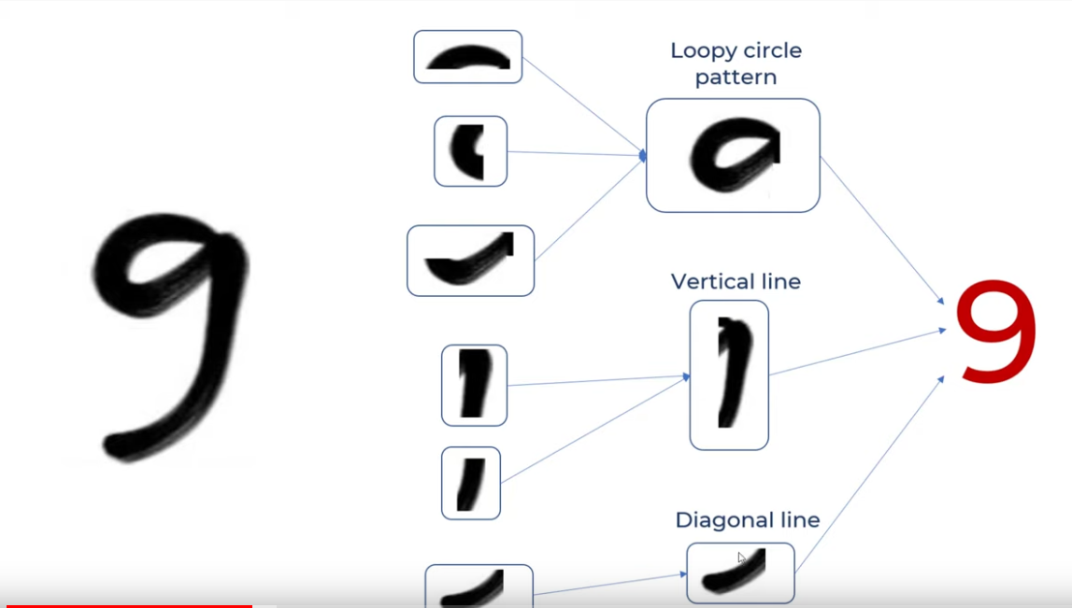

Slide 8
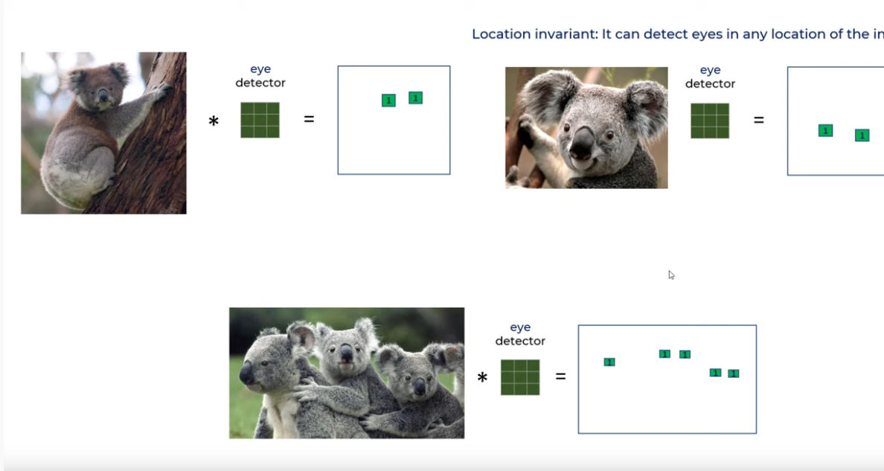

Slide 9
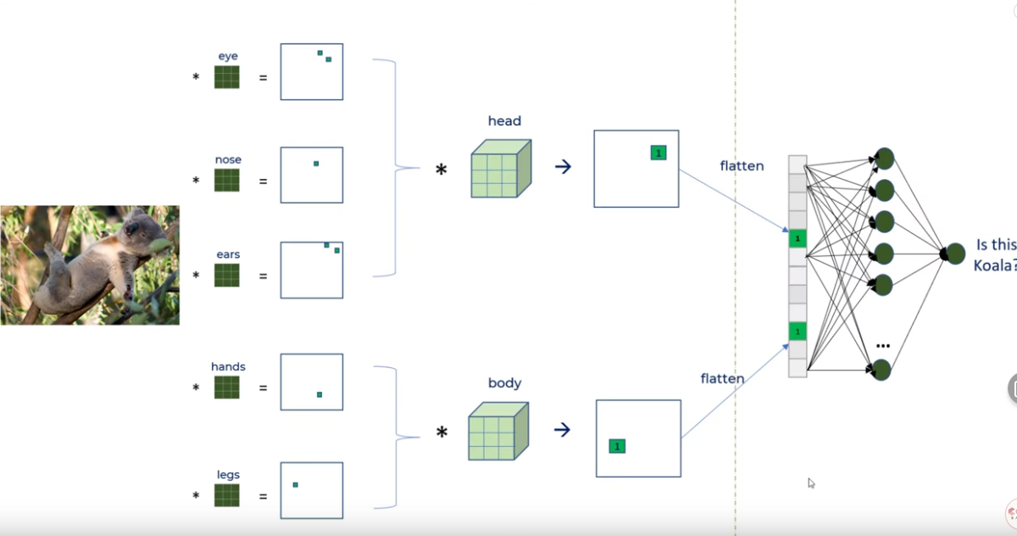

Slide 10
Deep Learning
It is a special type of machine learning where the learning algorithm extracts features automatically.
Unlike conventional ML algorithm, it does not require features to be extracted before giving the data to the algorithm.
It is a type of representation learning for making decisions, interpretation etc.

Slide 11
ML Vs Deep Learning

Slide 29
Activation Function

Slide 30
The Rectified Linear Unit

